Slide 1
Detecting compositionality using semantic vector space models based on syntactic context
ACL-HLT 2011 Workshop on Distributional Semantics and Compositionality (DiSCo 2011)
June 24, Portland, US
Shared Task System Description
Guillermo Garrido and Anselmo Peñas
NLP & IR Group at UNED
Madrid, Spain
{ggarrido,anselmo}@lsi.uned.es

Slide 2
Outline
About our participation
About the baselines

Slide 3
Hypotheses
Non-compositional compounds are units of meaning
Compound meaning should be different from the meaning of the compound head
Only partially true
Doesn’t cover all cases of non-compositionality
For similar approaches, see (Baldwin et al., 2003; Katz and Giesbrecht, 2006; Mitchell and Lapata, 2010).

Slide 4
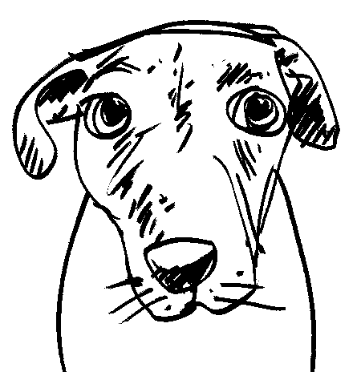
Example
≠

Slide 5
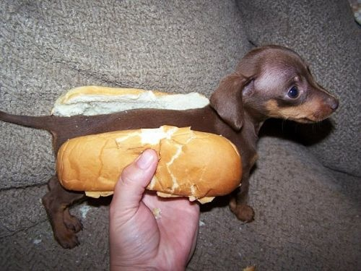
Compositional example
the hot-dog dog

Slide 6
Approach
Lexico-syntactic contexts obtained from large corpora (UkWaC)
A compound as a set of vectors in different vector spaces
Classifier that model the compositionality
Participation restricted to adjective-noun relations in English

Slide 7
Lexico-syntactic contexts
Matching the dependency trees to a set of pre-specified syntactic patterns
Similarly to (Pado and Lapata, 2007)
Frequency in the collection

Slide 8
Which Contexts?
Adjective + Noun
Syntactic dependency | Context Word
Subject of | <Verb>
Object of | <Verb>
Indirect Object of | <Verb>
Passive logical subject of | <Verb>
Passive subject of | <Verb>
has prepositional complement | <Noun>
modifies | <Noun>
Syntactic dependency | Context Word
is modified by | <Noun>
Subject of to be with Predicate | <Noun>
Predicate of to be with Subject | <Noun>
has possesive modifier | <Noun>
Is possesive modifier of | <Noun>
And a few more …

Slide 9
A compound as a set of vectors
A vector space for each syntactic dependency
<a, n> has a vector in each space
Compare <a, n> to its complementary <a^{c}, n>
Complementary of <a, n> :
Set of all adjective-noun pairs with the same noun but a different adjective:
<a^{c}, n> = {<b, n> | b≠a}

Slide 10
Example of vectors
hot dog
Syntactic Relation | Context Word | Frequency
an_obj | skewer:v | 26
 | eat:v | 9
 | buy:v | 4
 | get:v | 4
 | sell:v | 4
 | want:v | 4
 | … | …
ann | stand:n | 14
 | NAME | 11
 | stall:n | 5

Slide 11
Approach
Vector Space
Subj-of
Vector Space
Obj-of
hot^{c} dog
hot^{c} dog
hot dog
…
hot dog
cosine
hot dog
, compositionality value 1
blue chip
, compositionality value 2
…

Slide 12
Why?
We don’t know a priori what is the weight of each syntactic position
We can try also to study it as a feature selection process

Slide 13
Feature Selection
Genetic algorithm for feature selection.
Discarded:
prepositional complexes
noun complexes
indirect object
subject or attribute of the verb to be
governor of a possessive.
Among selected:
subject and objects of both active and passive constructions
dependent of possessives

Slide 14
Classifiers
Numeric evaluation task:
Regression model by a SVM classifier
Coarse scores:
Binned the numeric scores dividing the score space in three equally sized parts

Slide 15
Results (numeric ADJ-N task)
Run | Average Point Distance | Spearman’s correlation ρ | Kendall’s τ correlation
UoY:Pro-Best | 14.62 | 0.33 | 0.23
UCPH-simple.en | 14.93 | 0.18 | 0.27
UoY:Exm-Best | 15.19 | 0.35 | 0.24
UoY: Exm | 15.82 | 0,26 | 0,18
 |  | (not directly comparable, above is for all phrases, below for ADJ_NN)
RUN-SCORE-3 | 17.289 [5th] | 0.189 [12th] | 0.129 [12th]
RUN-SCORE-2 | 17.180 [6th] | 0.219 [11th] | 0.145 [11th]
RUN-SCORE-1 | 17.016 [7th] | 0.267 [8th] | 0.179 [9th]
0-response | 24.67 | – | –
Random | 34.57 | (0.02) | (0.02)

Slide 16
Outline
About our participation
About the baselines

Slide 17
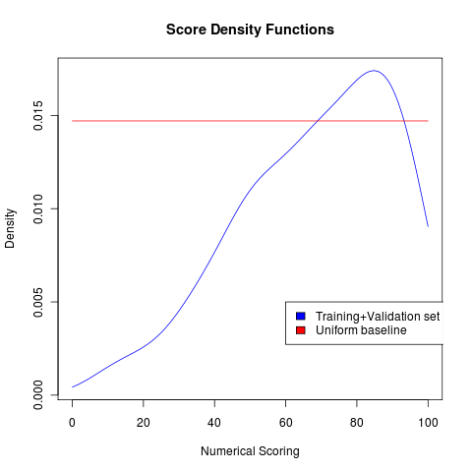
About the baselines
There is a bias in the training set:
Average score = 68.4
Standard deviation = 21.7
A simple baseline can benefit from this: output for every sample the average score over the training set.

Slide 18
Results
Compared to the baselines:
Run | Average Point Distance | Spearman’s correlation ρ | Kendall’s τ correlation
RUN-SCORE-1 | 17.016 | 0.267 | 0.179
RUN-SCORE-2 | 17.180 | 0.219 | 0.145
RUN-SCORE-3 | 17.289 | 0.189 | 0.129
Training average | 17.370 | – | –
0-response | 24.67 | – | –
Random | 34.57 | (0.02) | (0.02)

Slide 19
About the baselines
So, in addition to the paper baselines:
0-response:
always return score 0.5
Random baseline:
return a random score uniformly between 0 and 100
We propose:
Training average:
return the average of the scores available for training (68.412)

Slide 20
Conclusions
Modest results in the task:
5th best of a total of 17 valid systems in average point difference
But slightly above the average-score baseline
Worse in terms ranking correlation scores
We optimized for point difference
Did we learn anything? Did we confirm our hypotheses?
Not all syntactic contexts participate in the capture of meaning

Slide 21
Conclusions
Point difference has a strong baseline, using the sample bias:
In hind-sight, we believe the ranking correlation quality measures are more sensible than the point difference for this particular task.

Slide 22
Thanks!
Got questions?

Slide 23
Photo Credits
Dog’s face: http://schaver.com/?p=87
Hot dog: http://www.flickr.com/photos/bk/3829486195/
Hot-dog dog: http://gawker.com/5380716/hot-dogs-in-the-hallway-of-wealth

Slide 24
numerical scores | responses | ρ | τ | all | ADJ | SBJ | OBJ
0-response baseline | 0 | - | - | 23,42 | 24,67 | 17,03 | 25,47
random baseline | 174 | -0,02 | -0,02 | 32,82 | 34,57 | 29,83 | 32,34
UCPH-simple.en | 174 | 0,27 | 0,18 | 16,19 | 14,93 | 21,64 | 14,66
UoY: Exm-Best | 169 | 0,35 | 0,24 | 16,51 | 15,19 | 15,72 | 18,6
UoY: Pro-Best | 169 | 0,33 | 0,23 | 16,79 | 14,62 | 18,89 | 18,31
UoY: Exm | 169 | 0,26 | 0,18 | 17,28 | 15,82 | 18,18 | 18,6
SCSS-TCD: conf1 | 174 | 0,27 | 0,19 | 17,95 | 18,56 | 20,8 | 15,58
SCSS-TCD: conf2 | 174 | 0,28 | 0,19 | 18,35 | 19,62 | 20,2 | 15,73
Duluth-1 | 174 | -0,01 | -0,01 | 21,22 | 19,35 | 26,71 | 20,45
JUCSE-1 | 174 | 0,33 | 0,23 | 22,67 | 25,32 | 17,71 | 22,16
JUCSE-2 | 174 | 0,32 | 0,22 | 22,94 | 25,69 | 17,51 | 22,6
SCSS-TCD: conf3 | 174 | 0,18 | 0,12 | 25,59 | 24,16 | 32,04 | 23,73
JUCSE-3 | 174 | -0,04 | -0,03 | 25,75 | 30,03 | 26,91 | 19,77
Duluth-2 | 174 | -0,06 | -0,04 | 27,93 | 37,45 | 17,74 | 21,85
Duluth-3 | 174 | -0,08 | -0,05 | 33,04 | 44,04 | 17,6 | 28,09
submission-ws | 173 | 0,24 | 0,16 | 44,27 | 37,24 | 50,06 | 49,72
submission-pmi | 96 | - | - | - | - | 52,13 | 50,46
UNED-1: NN | 77 | 0,267 | 0,179 | - | 17,02 | - | -
UNED-2: NN | 77 | 0,219 | 0,145 | - | 17,18 | - | -
UNED-3: NN | 77 | 0,189 | 0,129 | - | 17,29 | - | -

